Slide 1
Manufacturing Processes - II
Module – 2 : Mechanics of Machining
Lecture – 4
Interrelations among the tool angles expressed
In different systems

Slide 2

Instructional objectives (content) of lecture – 4
(i) State the purposes of conversion of tool angles
from one system to another
(ii) Name the different methods of conversion of
tool angles
(iii) Convert tool angles by graphical method
      Rake angle : ASA ORS
      clearance angles : ASA ORS
(iv) Convert tool angles from ORS to NRS
Ascertain tool geometry in some specific
conditions.

Slide 3
(i) Purposes of conversion of tool angles
understand geometry if expressed in a
different system
derive benefits of different systems
communicate geometry to others who follow
different tool designation system

Slide 4

(ii) Different methods of conversion of
tool angles
Analytical (geometrical) method – simple but
tedious
Graphical Method (Masterline principle) – simple
quick and popular
Transformation matrix method – suitable for
complex tool geometry
Vector method – very simple and quick but
needs concept of vectors

Slide 5
Conversion of tool angles by Graphical method
- using Master lines
Conversion of rake angles : ASA ORS

Slide 6
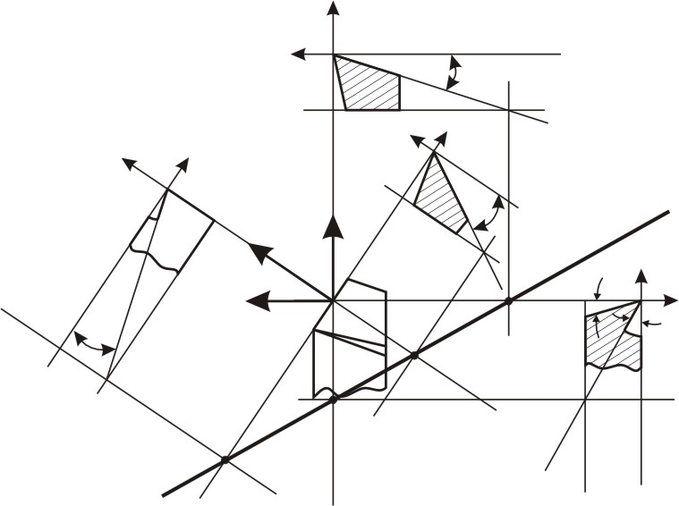
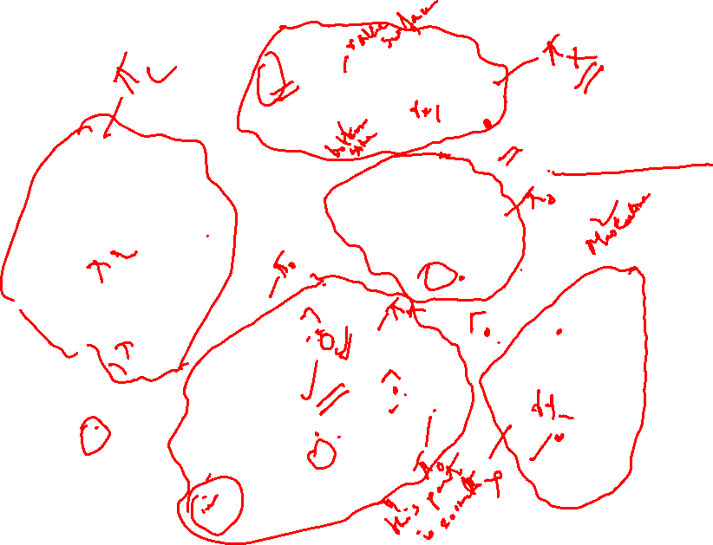
Z_{m}
X_{m}
γ_{x}
T
π_{X}
O'
Z_{o}
Z_{o}
X_{o}
D'
Y_{o}
π_{C}
Master line for rake surface
γ_{o}
O'
π_{o}
O'
Y_{m}
π_{R}
X_{o}
Y_{o}
T
C'
Y_{m}
O
O'
X_{m}
Z_{m}
λ
φ
D
π_{Y}
γ_{y}
π_{R}
C
π_{R}
T
A'
B
B'
T
A

Slide 7
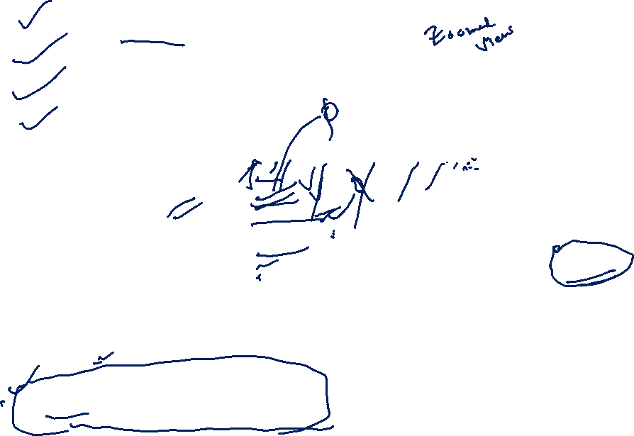
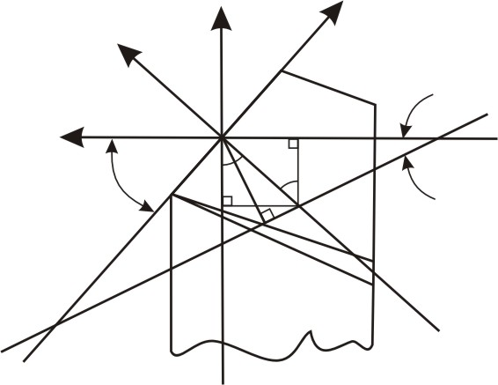
OD = Tcotγ_{X}
OB = Tcotγ_{Y}
OC = Tcotγ_{o}
OA = Tcotλ
Y_{m}
Y_{o}
X_{o}
Masterline of
Rake surface
X_{m}
G
O
F
D
φ
φ_{γ}
E
C
]
M
OD = cotγ_{x}
OB = cotγ_{y}
OC = cotγ_{o}
OA = cotλ
for T=unity
B
A
ΔOBD = Δ OBC + Δ OCD
Δ OAD = Δ OAB + Δ OBD

Slide 8
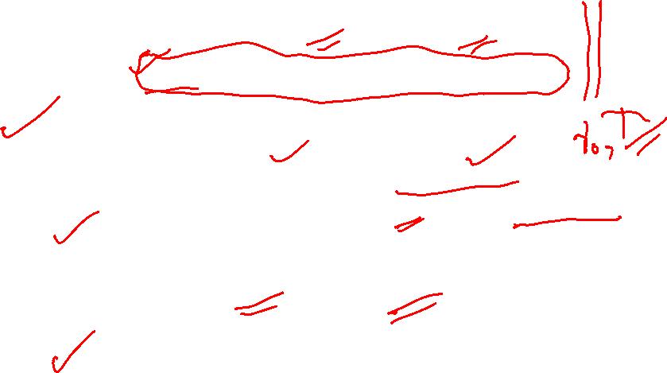
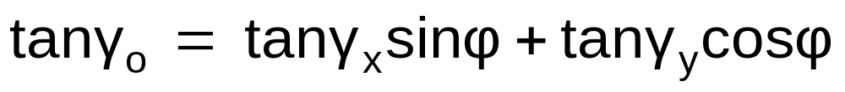

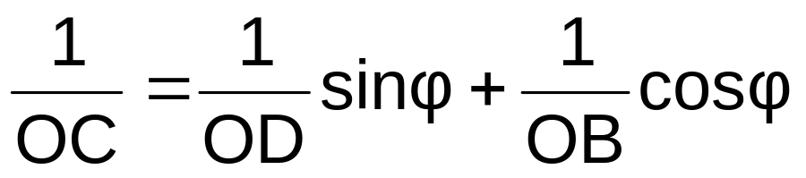
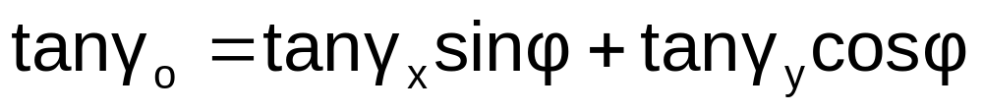
ΔOBD = Δ OBC + Δ OCD
Or, ½ OB.OD = ½ OB.CE + ½ OD.CF
Or, ½ OB.OD = ½ OB.OCsinφ + ½ OD.OCcosφ
Dividing both sides by ½ OB.OD.OC,
Conversion of clearance angles : ASA ORS

Slide 9
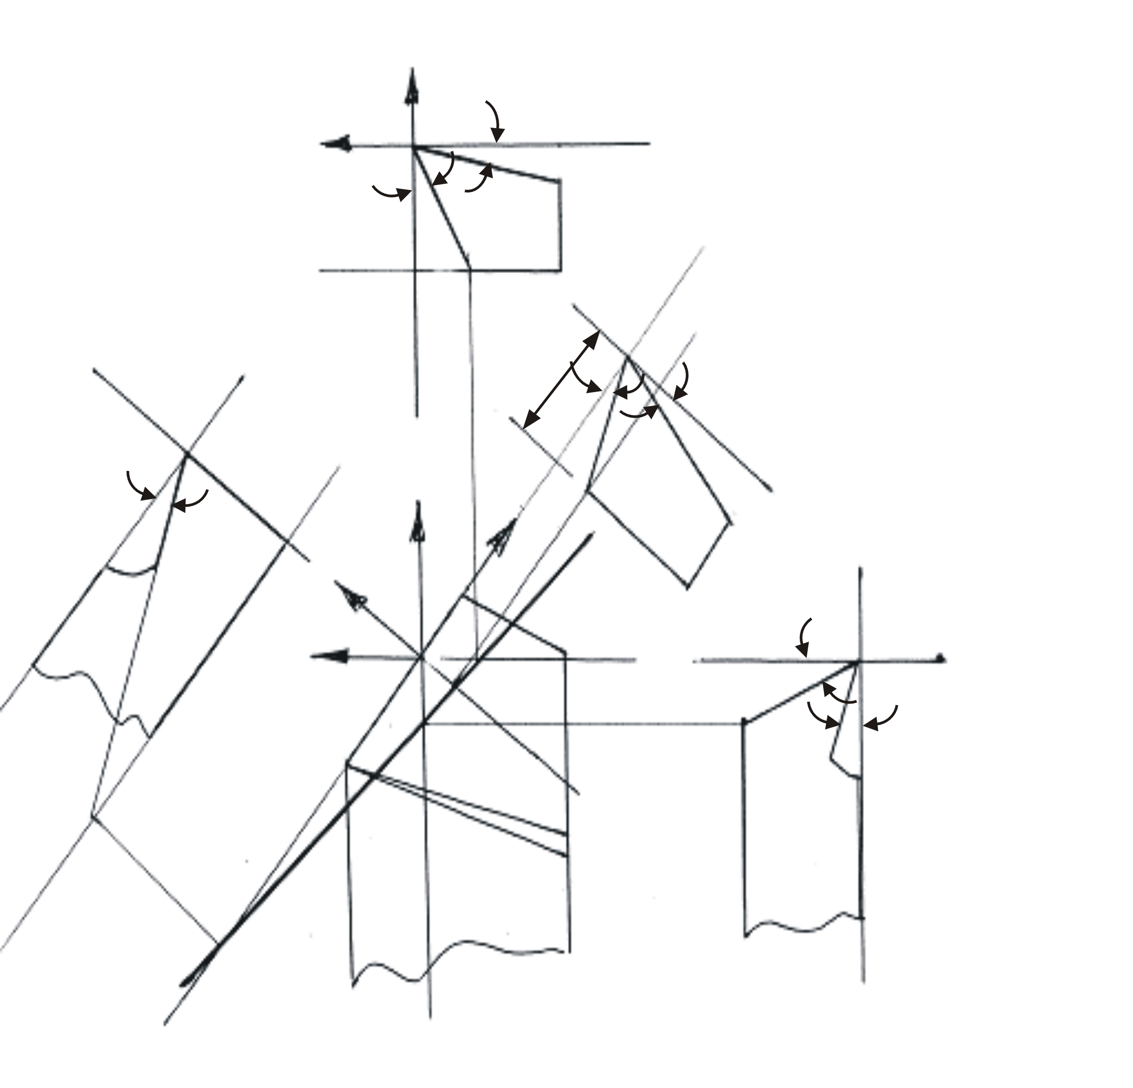

Z_{m}
γ_{x}
α_{x}
T
π_{x}
Z_{o}
D'
X_{o}
Z_{o}
Y_{o}
T
γ_{o}
α_{o}
λ
Y_{m}
Y_{o}
π_{o}
C'
X_{o}
Y_{o}
α_{y}
O
X_{m}
ML for principal flank
Z_{o}
D
C
γ_{y}
B
B'
A'
π_{y}
π_{R}
A
T

Slide 10
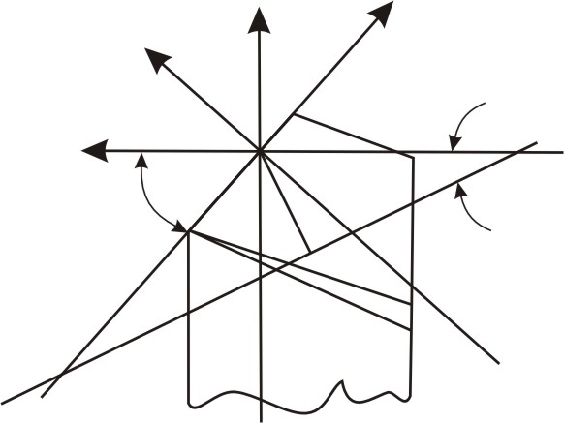

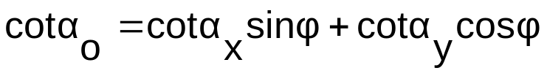

Y_{m}
Y_{o}
X_{o}
Master line for principal flank
D
X_{m}
O
φ
C
φ_{α}
M
]
B
OD = tanα_{x}
OB = tanα_{y}
OC = tanα_{o}
OA = cotλ
for
T=unity
A

Slide 11

(iii) Convert tool angles from ORS → NRS
Rake angles : determine γ_{n} (and λ) from γ_{o} and λ
γ_{n} = f (γ_{o} , λ)
tan γ_{n} = tan γ_{o} cos λ
cotα_{n} = cot α_{o} cos λ

Slide 12
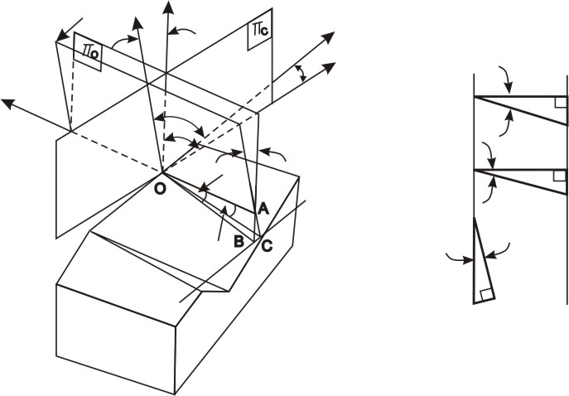
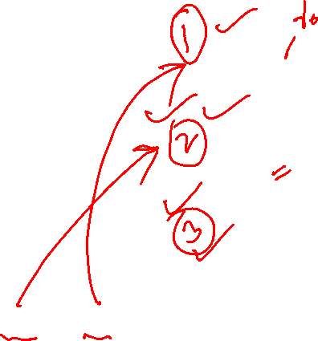
For rake angle conversion
Z_{o}
π_{n}
Z_{n}
Y_{n}
λ
λ
Y_{o}
γ_{o}
X_{o}, X_{n}
O
A
B
γ_{n}
λ
O
A
γ_{n}
A
C
γ_{o}
λ
π_{c}
C
B
AC = ABcosλ
OAtanγ_{n}= (OAtanγ_{o})cosλ

Slide 13
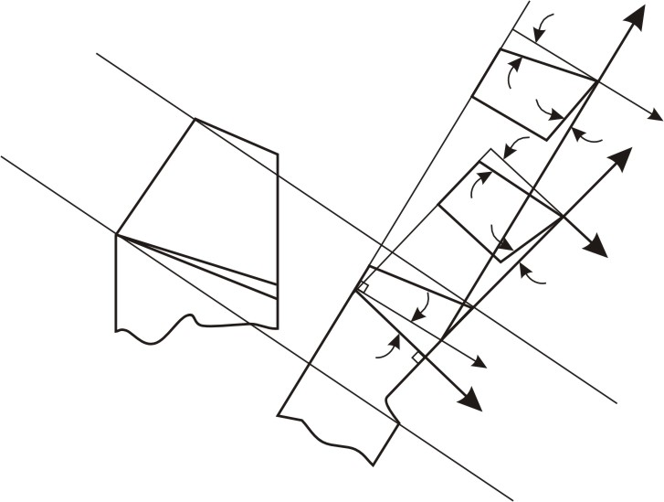

For clearance angle conversion
Y_{o}
α_{o}
A
A'
B
π_{C}
π_{o}
γ_{o}
Z_{o}
π_{o}
A
A'
α_{n}
Y_{n}
π_{n}
π_{R}
C
Z_{n}
A
γ_{n}
B
λ
Z_{o}
AC = ABcosλ
C
π_{C}
Z_{n}
AA’cotα_{n}= AA’cotα_{o}cosλ

